Slide 1

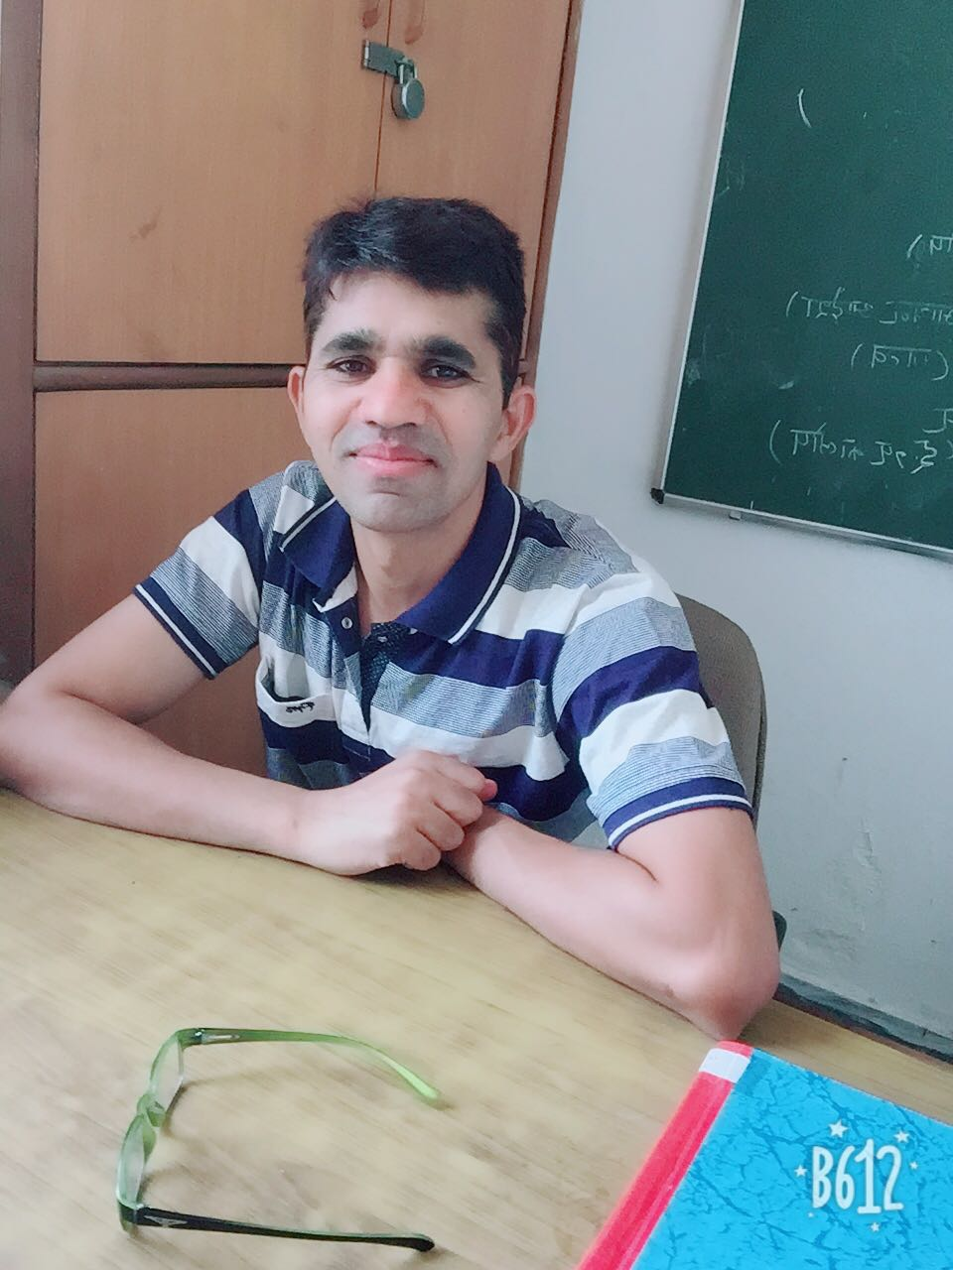
HANDINFG OVER & TAKING OVER CEREMONY OF NCC CHARGE OF S D COLLEGE, AMBALA CANTT. राष्ट्रीय कैडट कोर, एस० डी० कालेज, अम्बाला छावनी के दायित्व का हस्तान्तरण समारोह
6TH AUGUST, 2018
POTENTIAL OFFICER DR CHIMAN LAL, ANO, NCC

Slide 2
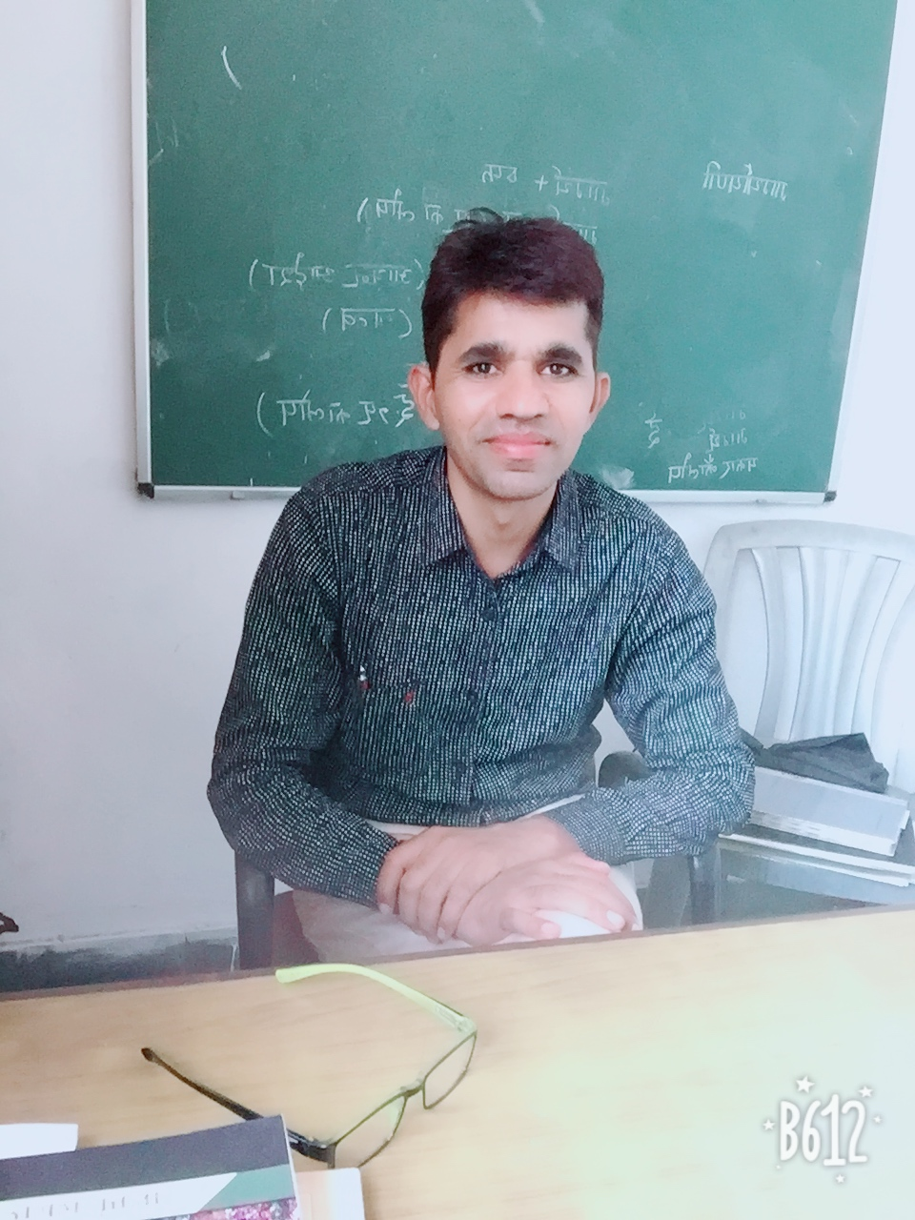
Dr. Chiman Lal, MA, M.phil; P.hd From KUK
Father name - Sh. Kanhaiya Lal
Mother name- smt Murti Devi
Date of birth. -7-9-1976
Date of place - Village- बालियर खुर्द Distt.- Rewari.Haryana.
Date of joining in this college - 2.8.2008
Publication : About ten paper published in national and international journals.
Minor Research project (MRP) completed.
NCC - C Certificate holder

Slide 3
His Core Values
Dr. Chiman Lal, ANO has
(a) A sense of patriotic commitment to encourage students to contribute to national development.
(b) Respect for diversities in religion, language, culture, ethnicity, life style and habitat to instill a sense of National unity and social cohesion.
(c) Abiding commitment to learn and adhere to the norms and values enshrined in the Indian Constitution.
(d) Understanding the value of a just and impartial exercise of authority.
(e) Ability to participate in community development and other social programme.
(f) A healthy life style free of substance abuse and other unhealthy practices.
(g) Sensitivity to the needs of poor and socially disadvantaged fellow citizens.
(h) habits of restraint and self-awareness.
(j) Understanding the values of honesty, truthfulness, self-sacrifice, perseverance and hard work.
(k) Respect for knowledge, wisdom and the power of ideas.

Slide 4




